Slide 1
Enhancing Memory Efficiency in Frequent Itemset Mining through Dynamic Prefix Tree Optimization
Team Details :
A. Sai Manideep Reddy (20EG105402)
B. Harshitha (20EG105405)
K. Adithya (20EG105417)
Project Supervisor
Dr. Pallam Ravi
Assistant Professor

Slide 2
Introduction
Frequent itemset mining is a data mining technique which is used to discover interesting patterns or associations within a dataset.
It's primarily applied in transactional databases or datasets where items are purchased, accessed, or interacted with in some way.
The goal is to identify patterns of co-occurrence among items, which can provide valuable insights into customer behavior, market trends, and association rules.
Applications of frequent itemset mining are Market Basket Analysis, Healthcare, Network Traffic Analysis, Text Mining and Natural Language Processing etc.

Slide 3
Problem Statement
Frequent Itemset Mining (FIM) plays a pivotal role in extracting meaningful patterns and associations from large datasets, finding applications in diverse fields such as market basket analysis, bioinformatics, and network intrusion detection.
The primary objective of FIM is to identify sets of items that frequently co-occur in transactions.
Traditional algorithms, such as Apriori and FP-growth, have been instrumental in this process but they have their limitations, particularly in terms of scalability, memory consumption, and computational overhead.
The need for an optimized approach that overcomes these challenges becomes evident. So a novel data structure is proposed called Dynamic Prefix Tree (DPT) to enhance the efficiency of frequent itemset mining.

Slide 4
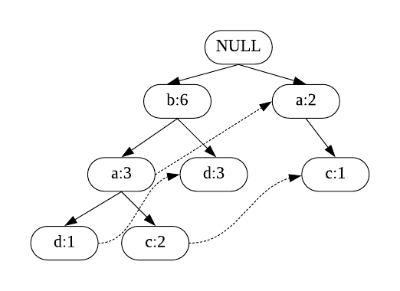
Problem Illustration
Example:
Transaction ID | Itemset
1 | {a, b, c, e}
2 | {b, d}
3 | {a, c, e}
4 | {a, b, c, f}
5 | {b, d, g}
6 | {a, b, d, h}
7 | {a, h}
8 | {b, d, g}
FP Tree (Prefix Tree)
Dataset for FP-Growth Algorithm

Slide 5
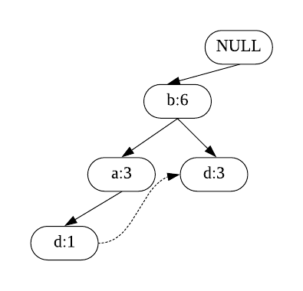
Problem Illustration
{NULL}
|
b:4
d conditional FP tree
conditional FP-tree of “ad”, ba:1
Item | Conditional Pattern
b | { }
a | b:3
d | b:3, ba:1
c | a:1, ba:2
{NULL}
|
b:4
|
a:1
conditional FP-tree of “d”, ba:1
conditional FP-tree of “bd”, b:3
{NULL}
conditional FP-tree of “bad”, ba:1
All frequent patterns to d:
d
bd, ad
bad
{NULL}

Slide 6
Proposed Method
The Proposed Method is Dynamic Prefix Tree.
The dynamic prefix tree is a data structure used to efficiently discover frequent itemsets in large transaction databases.
The dynamic prefix tree, often associated with algorithms like FP-Growth (Frequent Pattern Growth), is a compact representation of the transaction database that facilitates efficient pattern discovery.

Slide 7
Proposed Method
Illustration :
Transaction ID | Itemset
1 | {a, b, c, e}
2 | {b, d}
3 | {a, c, e}
4 | {a, b, c, f}
5 | {b, d, g}
6 | {a, b, d, h}
7 | {a, h}
8 | {b, d, g}
Prefix Tree
Dataset

Slide 8
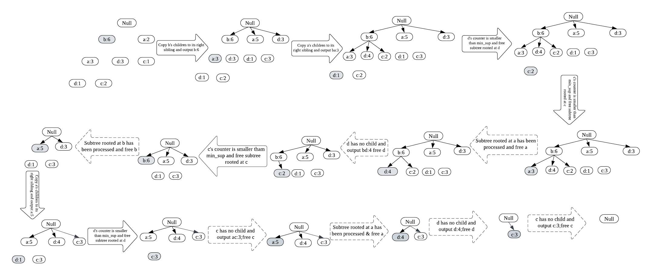

Slide 9
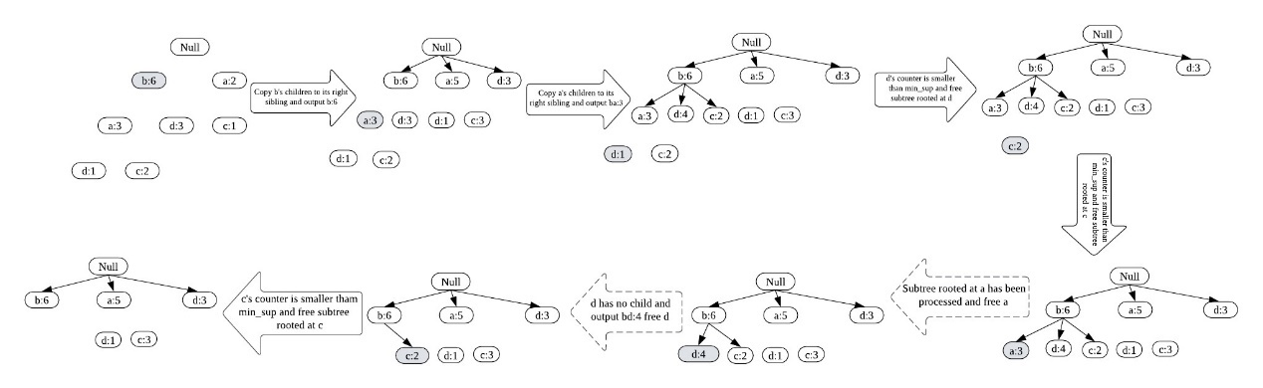
An Experimental Study
Reducing the DPT calls
a | b | c | d | e | f | g | h
5 | 6 | 3 | 4 | 2 | 1 | 2 | 2
Global counter of each item
Reducing the DPT calls

Slide 10
Reducing the Nodes
a | b | c | d
5 | 6 | 3 | 4
a | b | c | d
8 | 6 | 4 | 7
a | b | c | d
8 | 6 | 7 | 9
a | b | c | d
8 | 6 | 7 | 8
Global Counter
Global count of first DPT call
Global count of second DPT call
Global count of third DPT call
a | b | c | d
8 | 6 | 5 | 8
a | b | c | d
5 | 6 | 5 | 8
a | b | c | d
5 | 6 | 5 | 4
a | b | c | d
5 | 0 | 3 | 4
Global count of fourth DPT call
Global count of fifth DPT call
Global count of sixth DPT call
Global count of eighth DPT call
a | b | c | d
0 | 0 | 3 | 4
a | b | c | d
0 | 0 | 3 | 0
a | b | c | d
0 | 0 | 0 | 0
Global count of twelfth DPT call
Global count of thirteenth DPT call
Global count of fourteenth DPT call

Slide 11
The attempt to integrate the Maximum Frequent Itemset (MFI) list algorithm with the Dynamic Prefix Tree (DPT) algorithm for finding maximal itemsets encountered challenges, ultimately resulting in failure. The failure can be attributed to several factors, primarily stemming from the complexity and intricacies involved in synchronizing the two algorithms seamlessly. One of the critical points of failure lies in the process of traversing the MFI list and simplifying the FP-tree. While the MFI list aims to identify maximal frequent itemsets efficiently, the integration with the DPT algorithm introduces additional complexities in managing the tree structure and support counts, leading to discrepancies in the traversal process.
Finding the Maximal Frequent Itemsets using Dynamic Prefix Tree
The attempt to integrate the Maximum Frequent Itemset (MFI) list algorithm with the Dynamic Prefix Tree (DPT) algorithm for finding maximal itemsets encountered challenges, ultimately resulting in failure.
The failure can be attributed to several factors, primarily stemming from the complexity and intricacies involved in synchronizing the two algorithms seamlessly.
One of the critical points of failure lies in the process of traversing the MFI list and simplifying the FP-tree. While the MFI list aims to identify maximal frequent itemsets efficiently, the integration with the DPT algorithm introduces additional complexities in managing the tree structure and support counts, leading to discrepancies in the traversal process.

Slide 12
Experiment Environment
Eclipse IDE:
-Eclipse is an integrated development environment (IDE) used in computer programming, especially for developing applications using Java.
-It contains a base workspace and an extensible plug-in system for customizing the environment with tools for various programming languages, version control systems, and other development tasks.
JDK :
-Java Development Kit (JDK) is a software development environment used for developing Java applications and applets.
-It includes the Java Runtime Environment (JRE), an interpreter/loader, a compiler.
Dataset Repository:
-The FIMI (Frequent Itemset Mining) repository is a widely used source for benchmark datasets from different domains like retail, text, web, DNA etc., related to frequent pattern mining research.

Slide 13
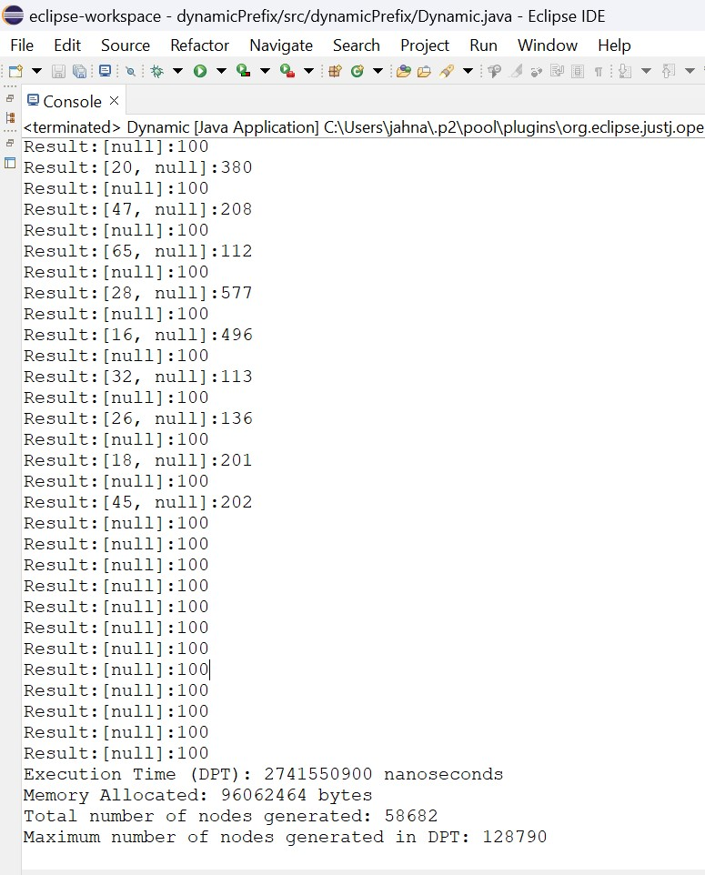
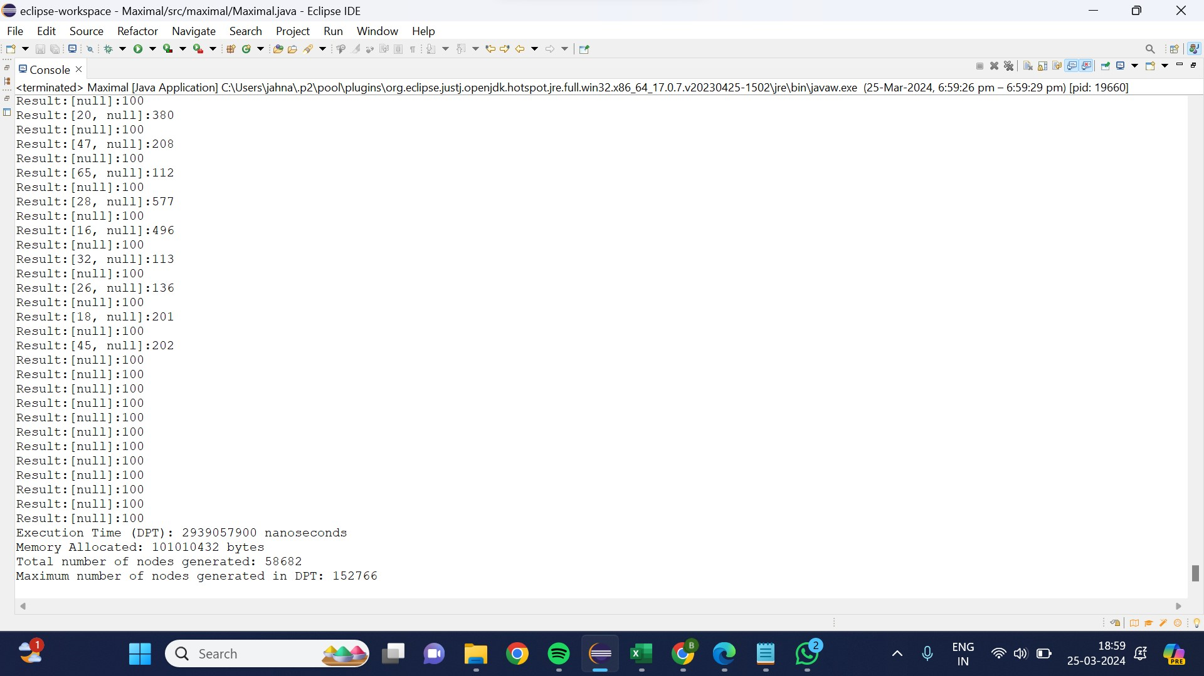
Experiment Screenshots
With Optimization
Without Optimization
Dataset: Chess

Slide 14
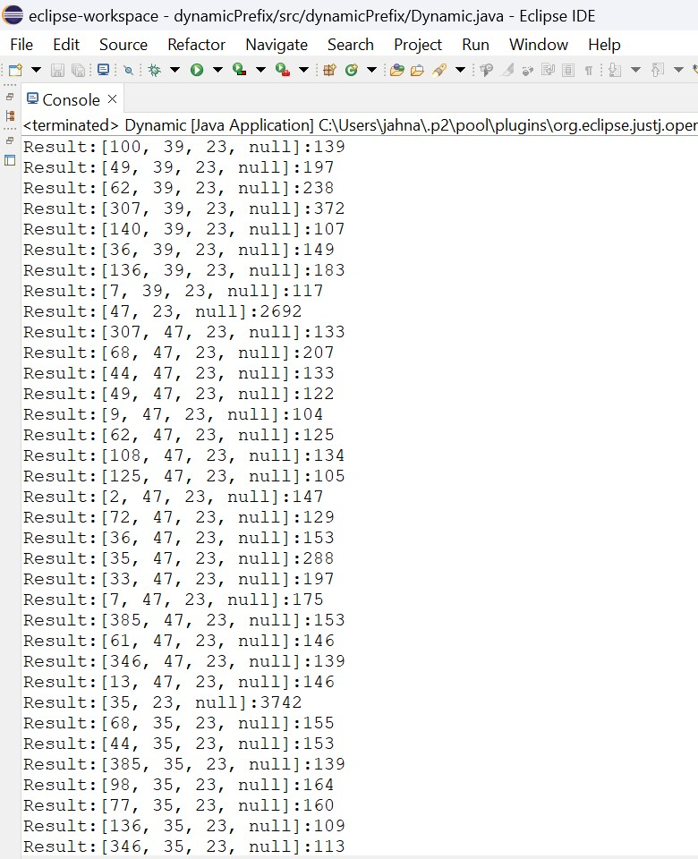
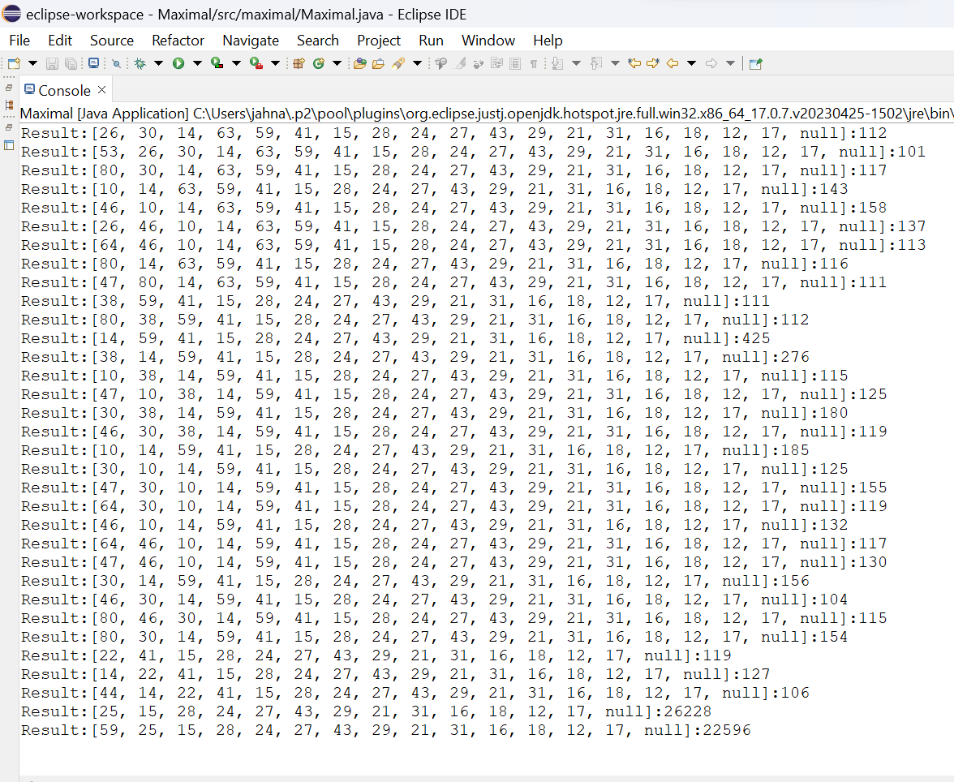
Experiment Screenshots
With Optimization
Without Optimization
Dataset: Accidents

Slide 15
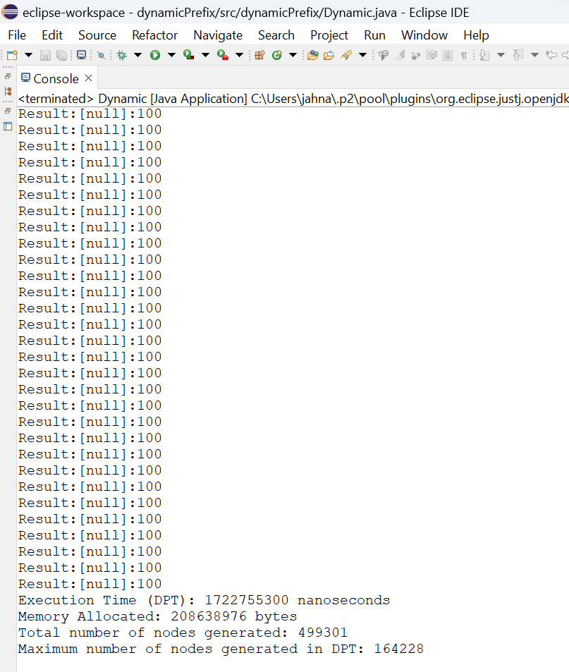
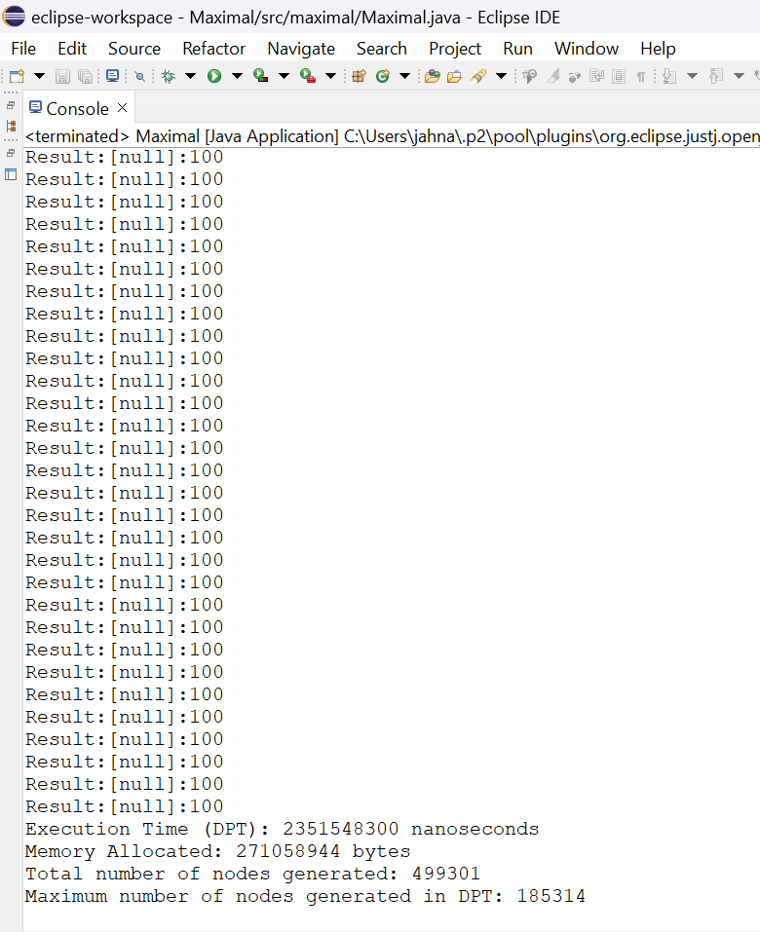
Experiment Screenshots
With Optimization
Dataset: T1OL4D100K
Without Optimization

Slide 16
Experiment Results
Dataset: T1OL4D100K

Slide 17
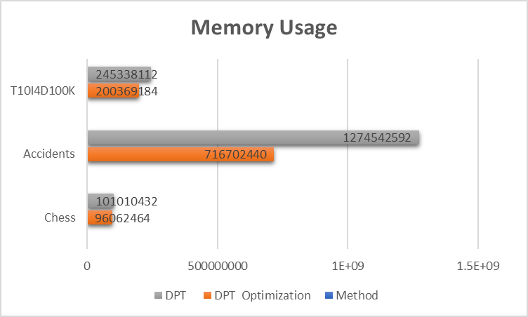
Experiment Results

Slide 18
Findings
Dynamic prefix tree is easily implemented in object-oriented programming. There are many advantages like:
Firstly, OOP facilitates modularity by organizing the DPT implementation into smaller, manageable classes, simplifying development and maintenance. Secondly, encapsulation hides the internal details of the tree structure, exposing only the necessary interfaces for interaction, thus reducing complexity. Additionally, polymorphism allows flexibility by treating objects of different classes as instances of a common superclass, enabling seamless integration of various functionalities.
The drawback of assuming single occurrences of items in the dataset undermines the reliability of support counts and may lead to inaccurate pattern identification and premature pruning, ultimately compromising the effectiveness of the DPT algorithm in analyzing the dataset.
The complexity introduced by merging and copying subtrees within the Dynamic Prefix Tree (DPT) algorithm, coupled with the complexity of managing multiple algorithms within a unified framework, poses significant challenges in finding maximal itemsets. The process of synchronizing these algorithms becomes difficult to deal, especially considering the dynamic adjustments made during subtree copying and merging.

Slide 19
Justification
Parameters
Space Complexity (Memory allocated) and Time Complexity ( Execution Time)
Formula
Space Complexity: Memory = Total Runtime Memory –Free Runtime Memory
Time Complexity: Execution Time = End Time – Start Time
In what way the parameters are improved
Space Complexity: By reducing the nodes that are generated in the Dynamic Prefix Tree the memory usage is reduced.
Time Complexity: The Time Complexity is reduced as the number of nodes decreased.

Slide 20
Thank You

